Slide 1
pyTigerGraph
Check out the documentation https://docs.tigergraph.com/pytigergraph/current/intro/

Slide 2
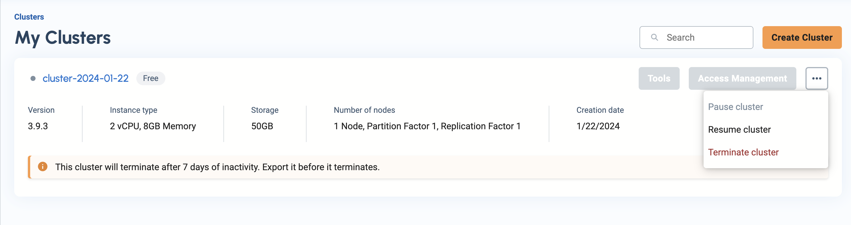
Start TigerGraph Cluster

Slide 3


Make new folder for project_4

Slide 4




Create and start your virtual environment
Windows
Create and name VENV
Activate the VENV
Mac/Linux
Create and name VENV
Activate the VENV
Windows 10 & 11: set execution policy

Slide 5
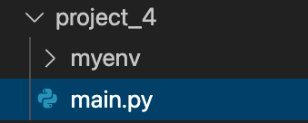
Create main.py file inside project_4
If Mac/Linux:
If PC:
File structure should look like this so far:

Slide 6
Upgrade PIP (if needed)

Slide 7

Installing and importing pyTigerGraph
Install with PIP
Import into python
Documentation: Here

Slide 8
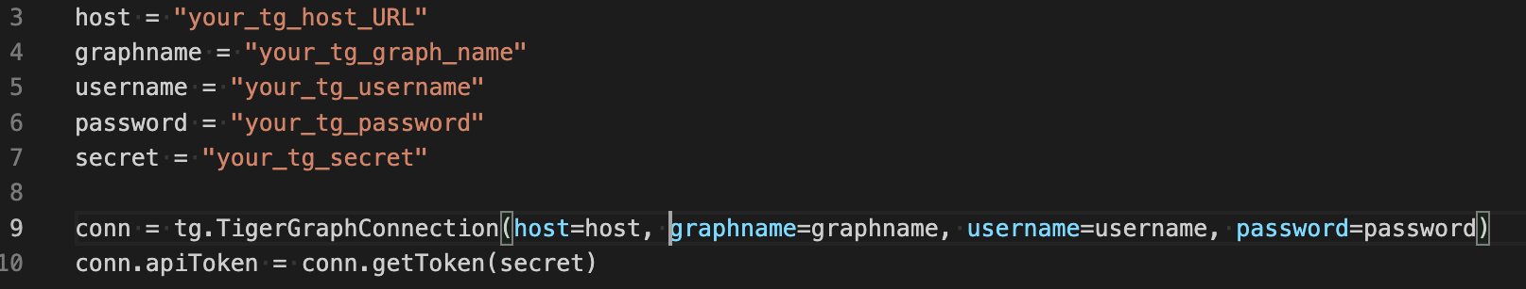
Connecting to a graph
Things we need: 1. Host URL
2. Graph name
3. Tiger Graph username
4. Tiger Graph password
5. Tiger Graph secret

Slide 9
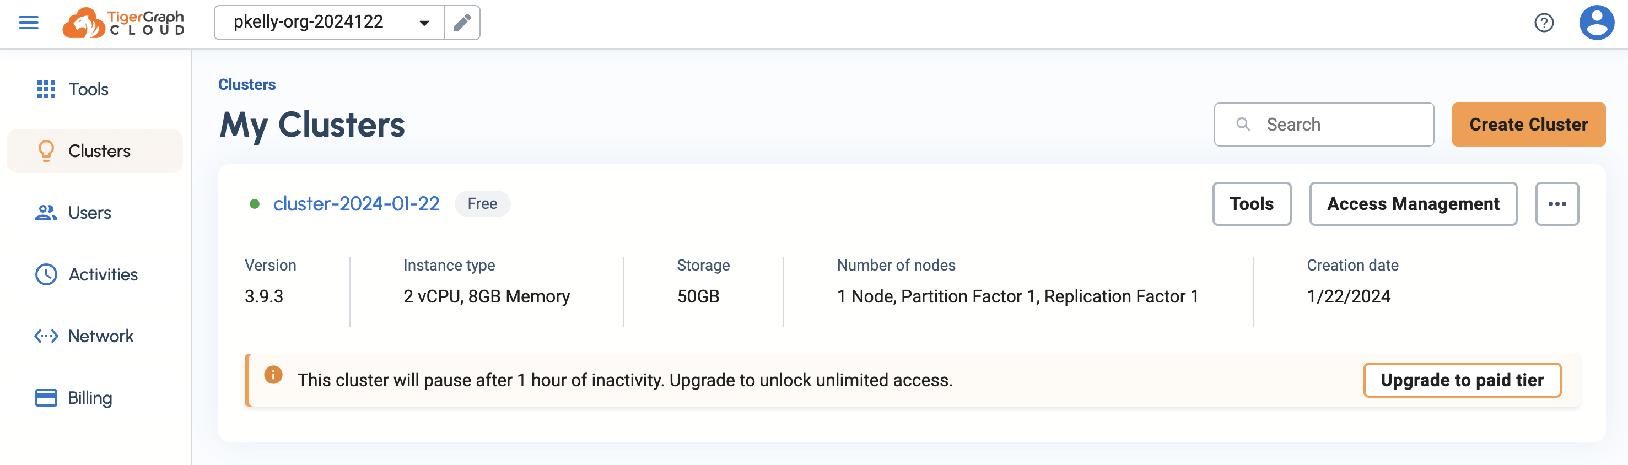
Where to find your TigerGraph host
Click Here

Slide 10
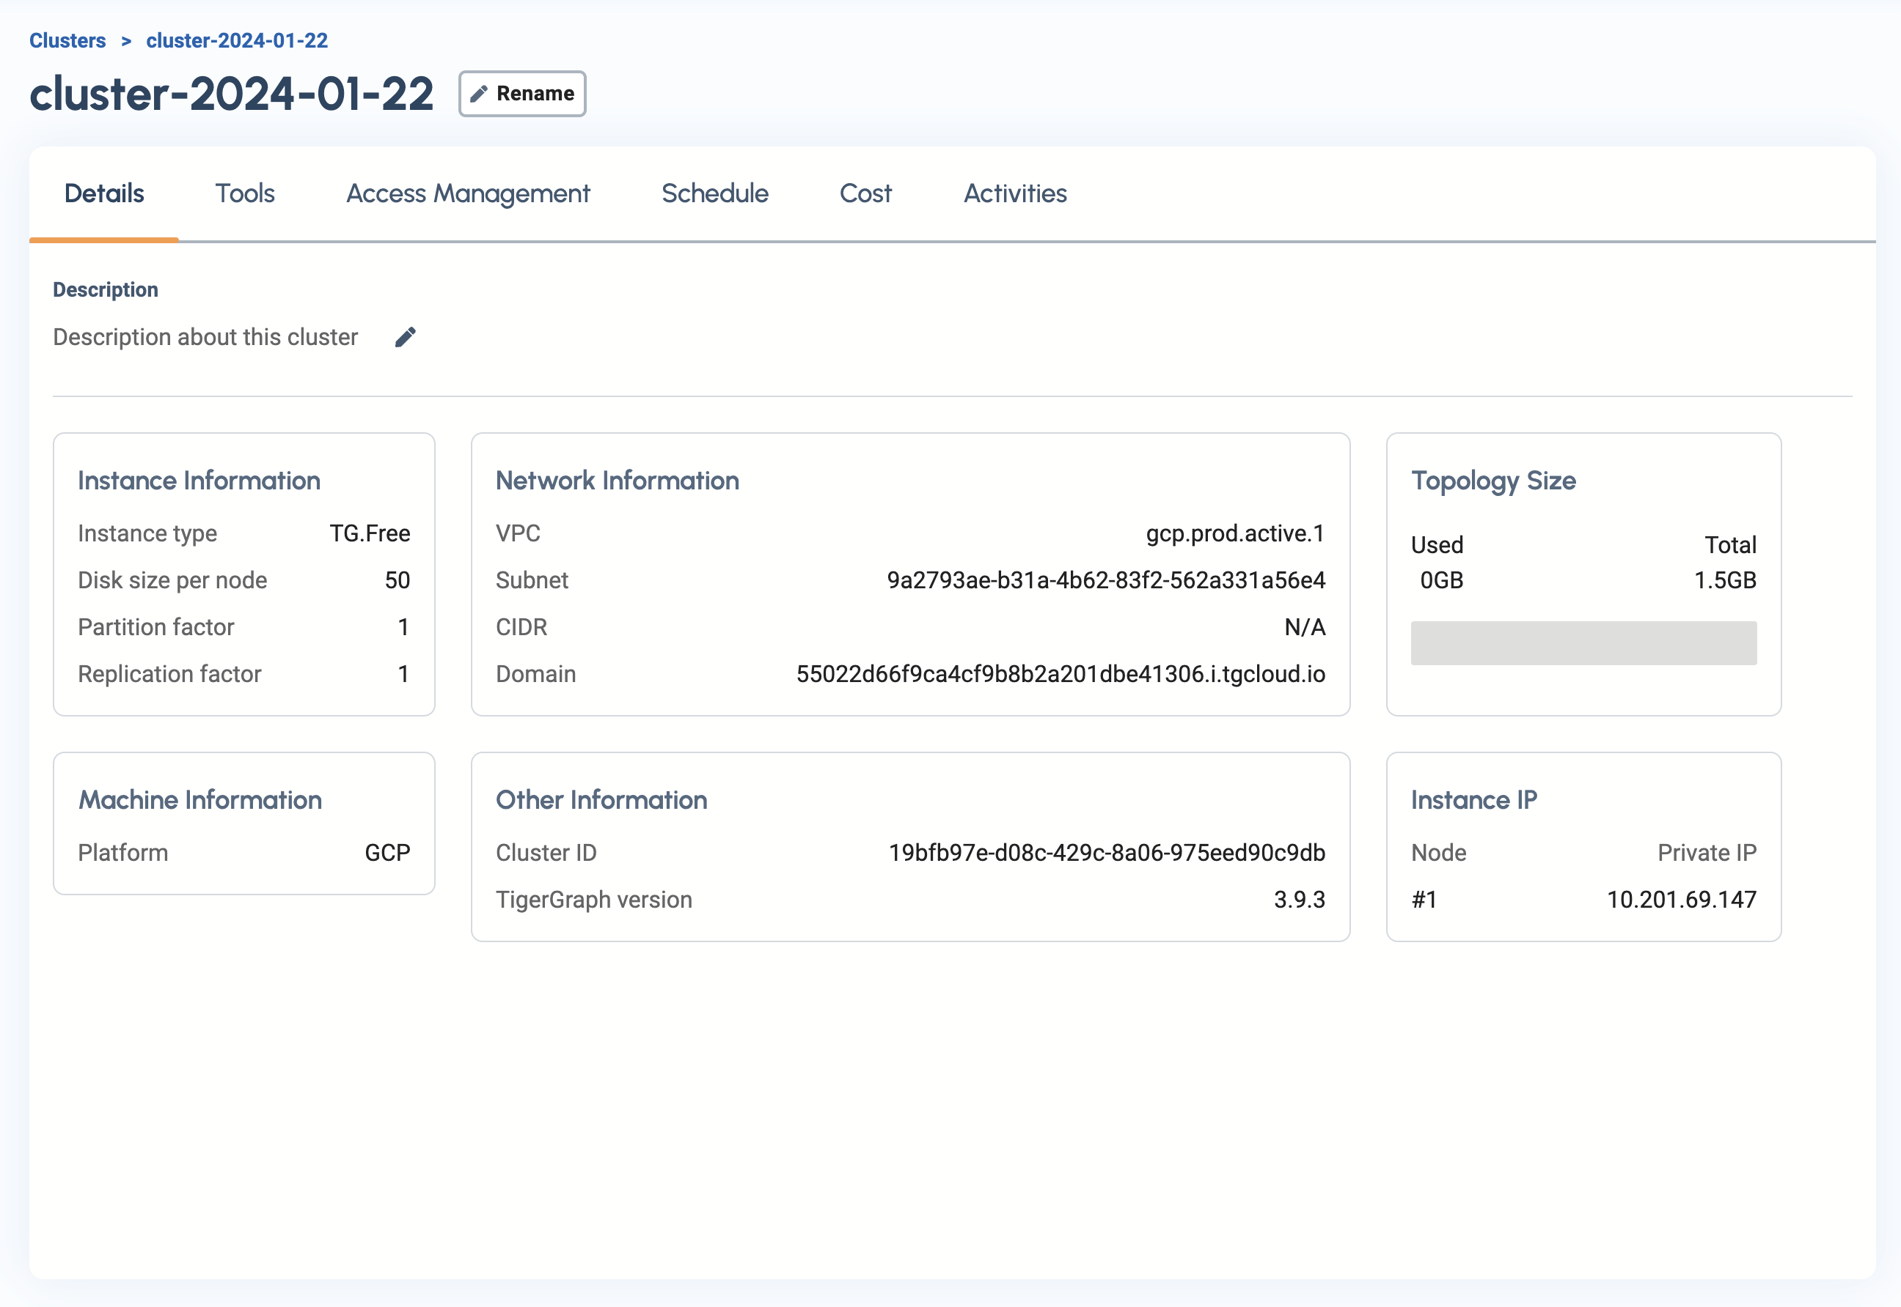
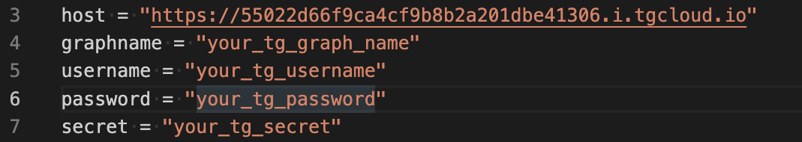
Cluster Details
This is your host URL click to copy and then
past into your code

Slide 11
Like this (your host will be unique to the cluster)

Slide 12
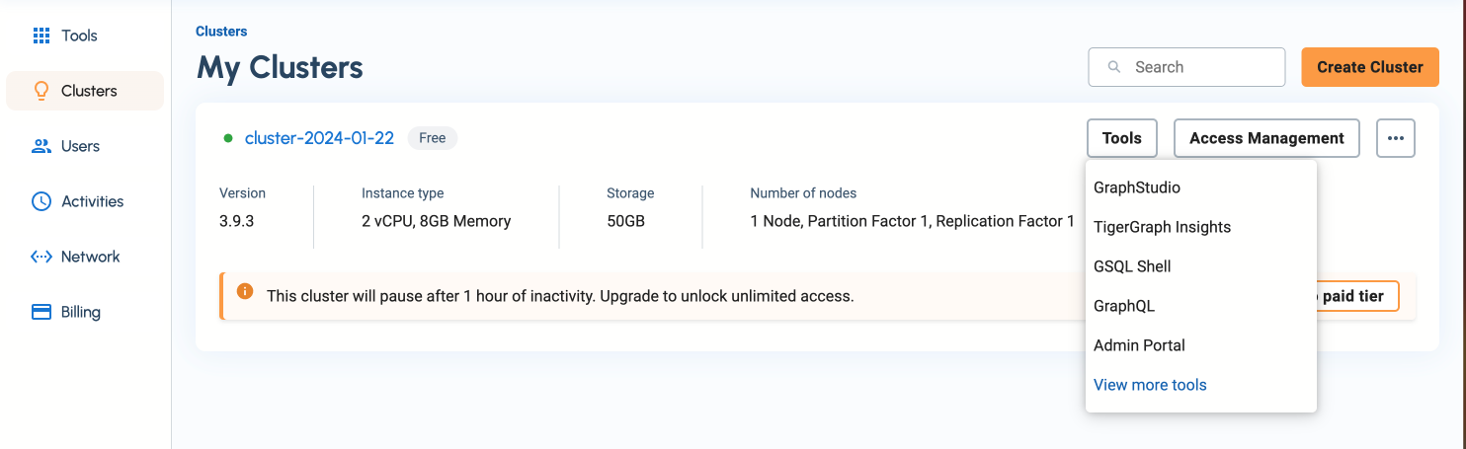
Where to find your Graph Name
Click Here

Slide 13
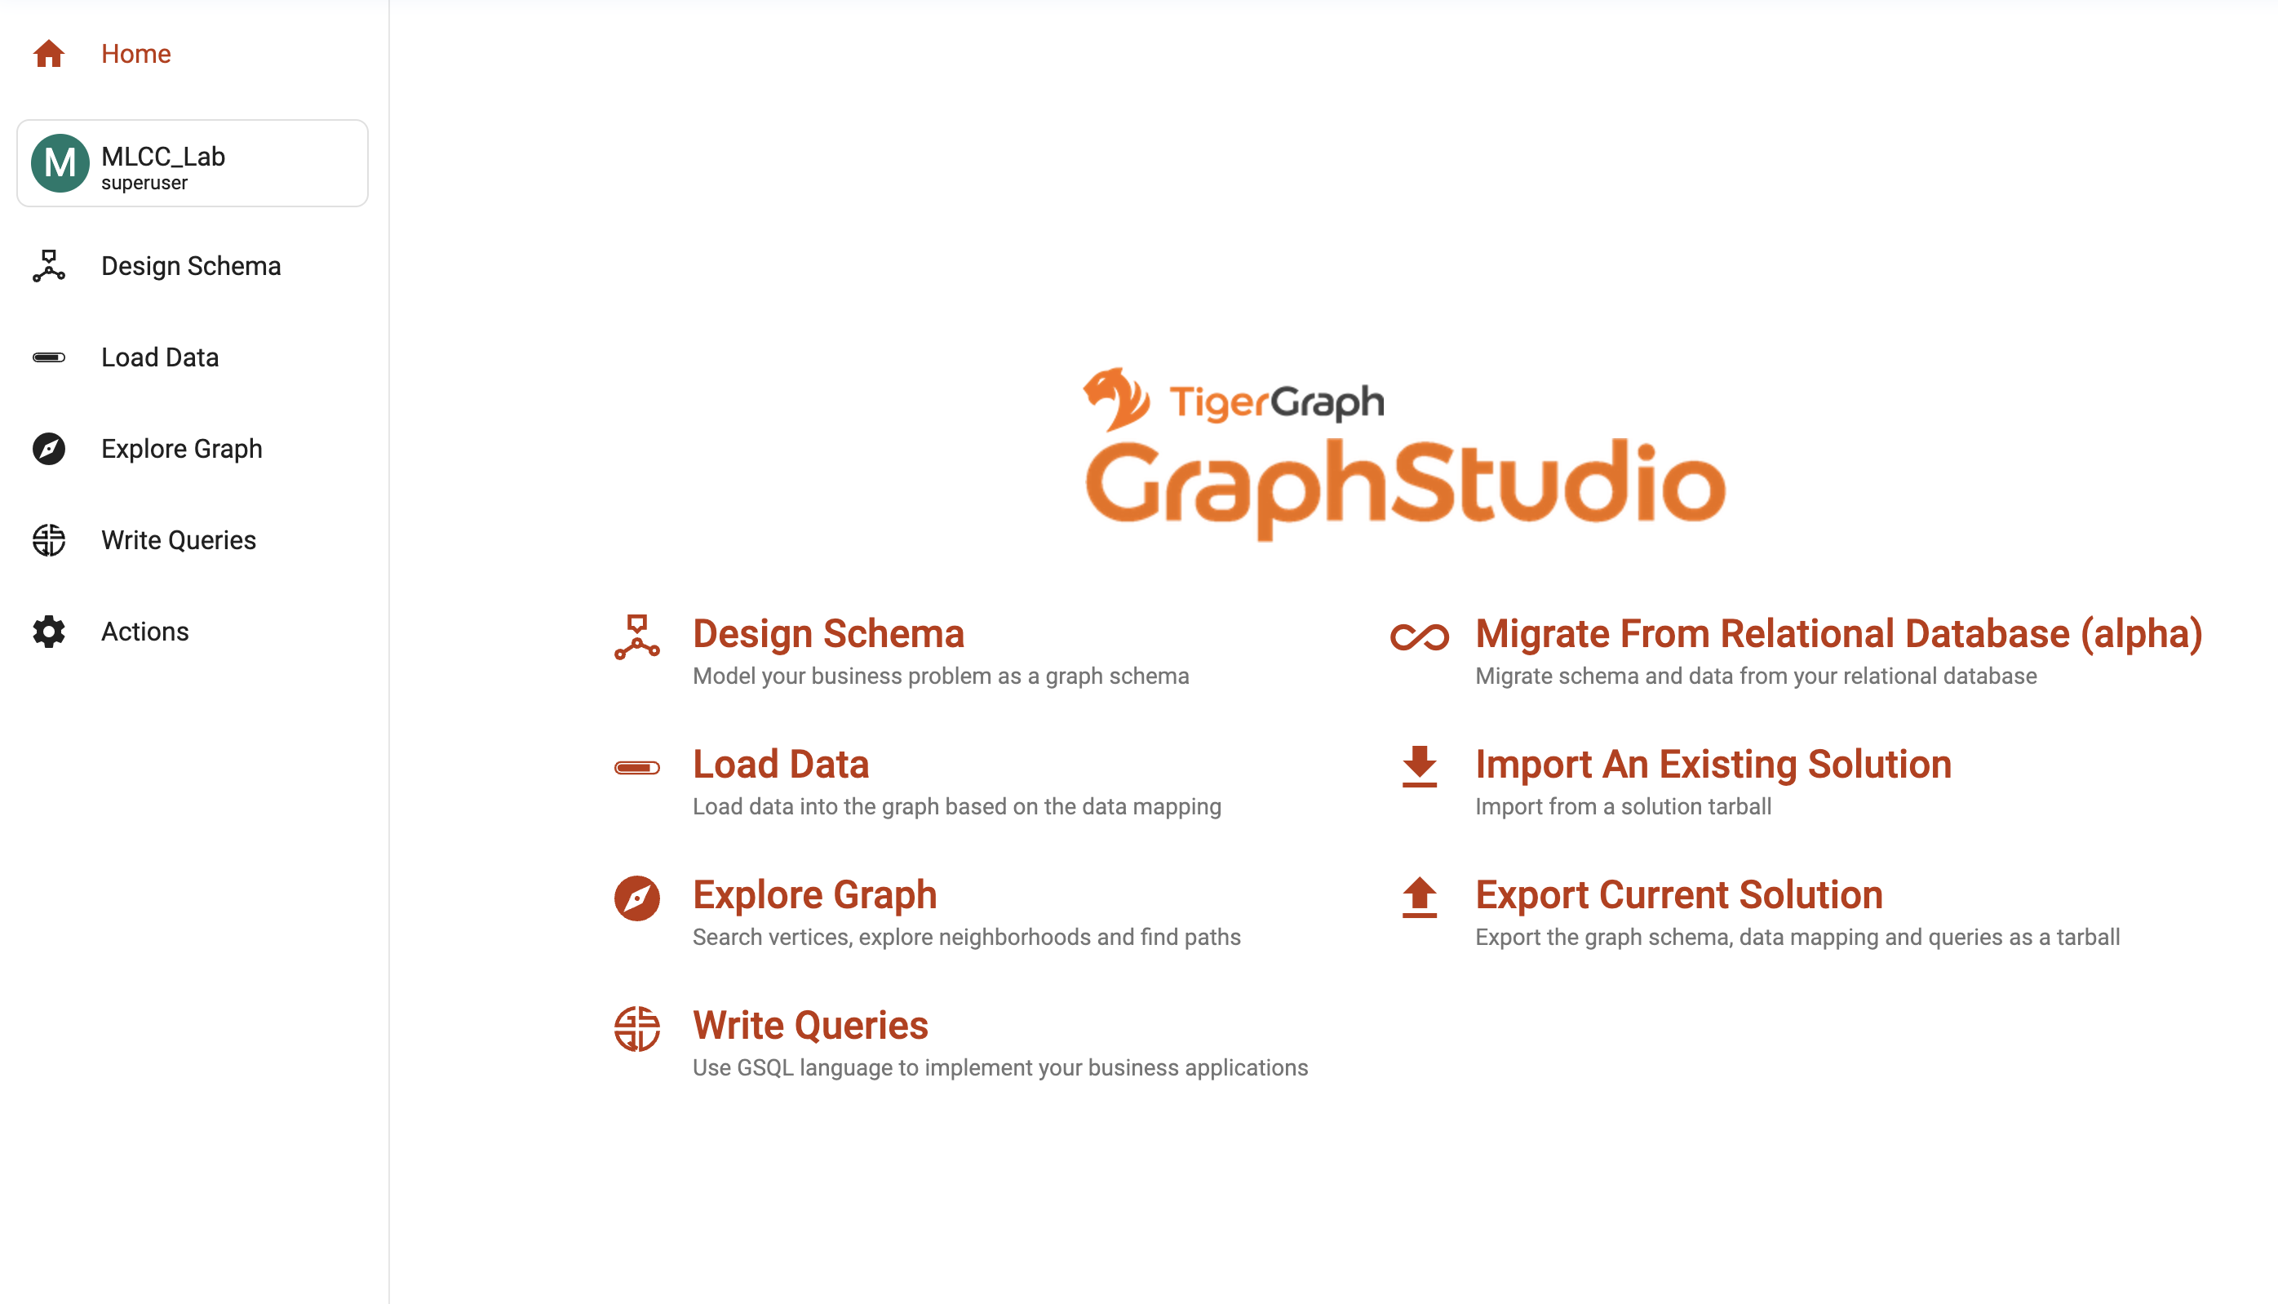
Here is the Graph Name

Slide 14
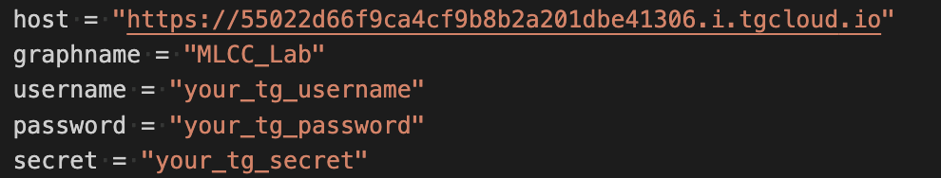
Like this

Slide 15
Where to find your username
Click Here

Slide 16
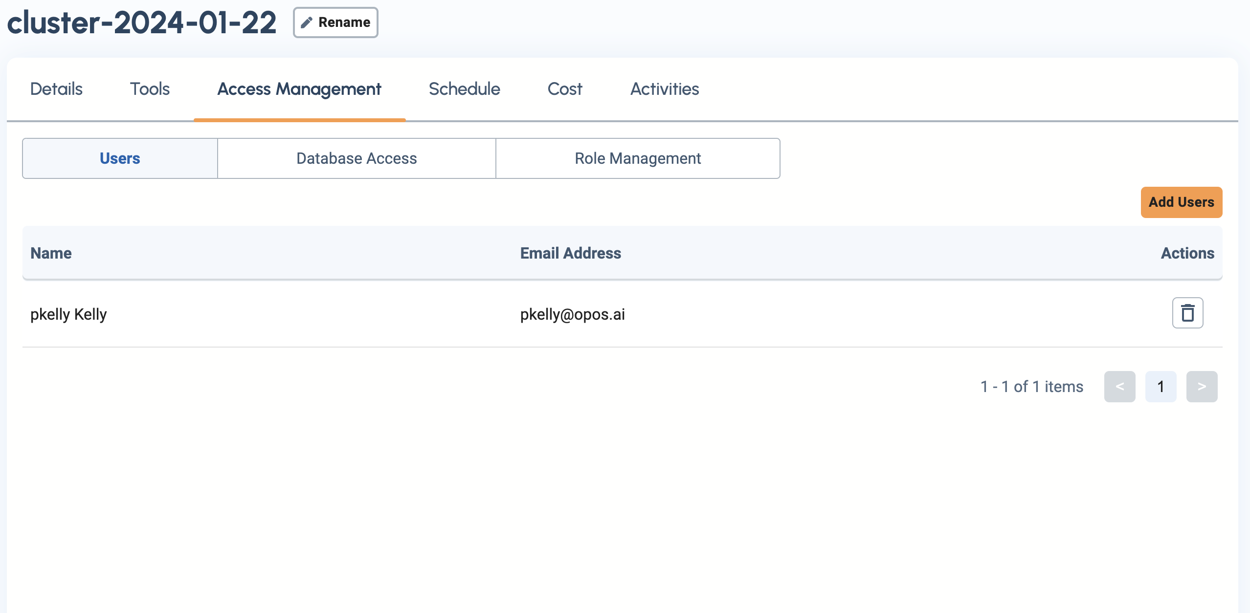
Finding your username
Click Here

Slide 17
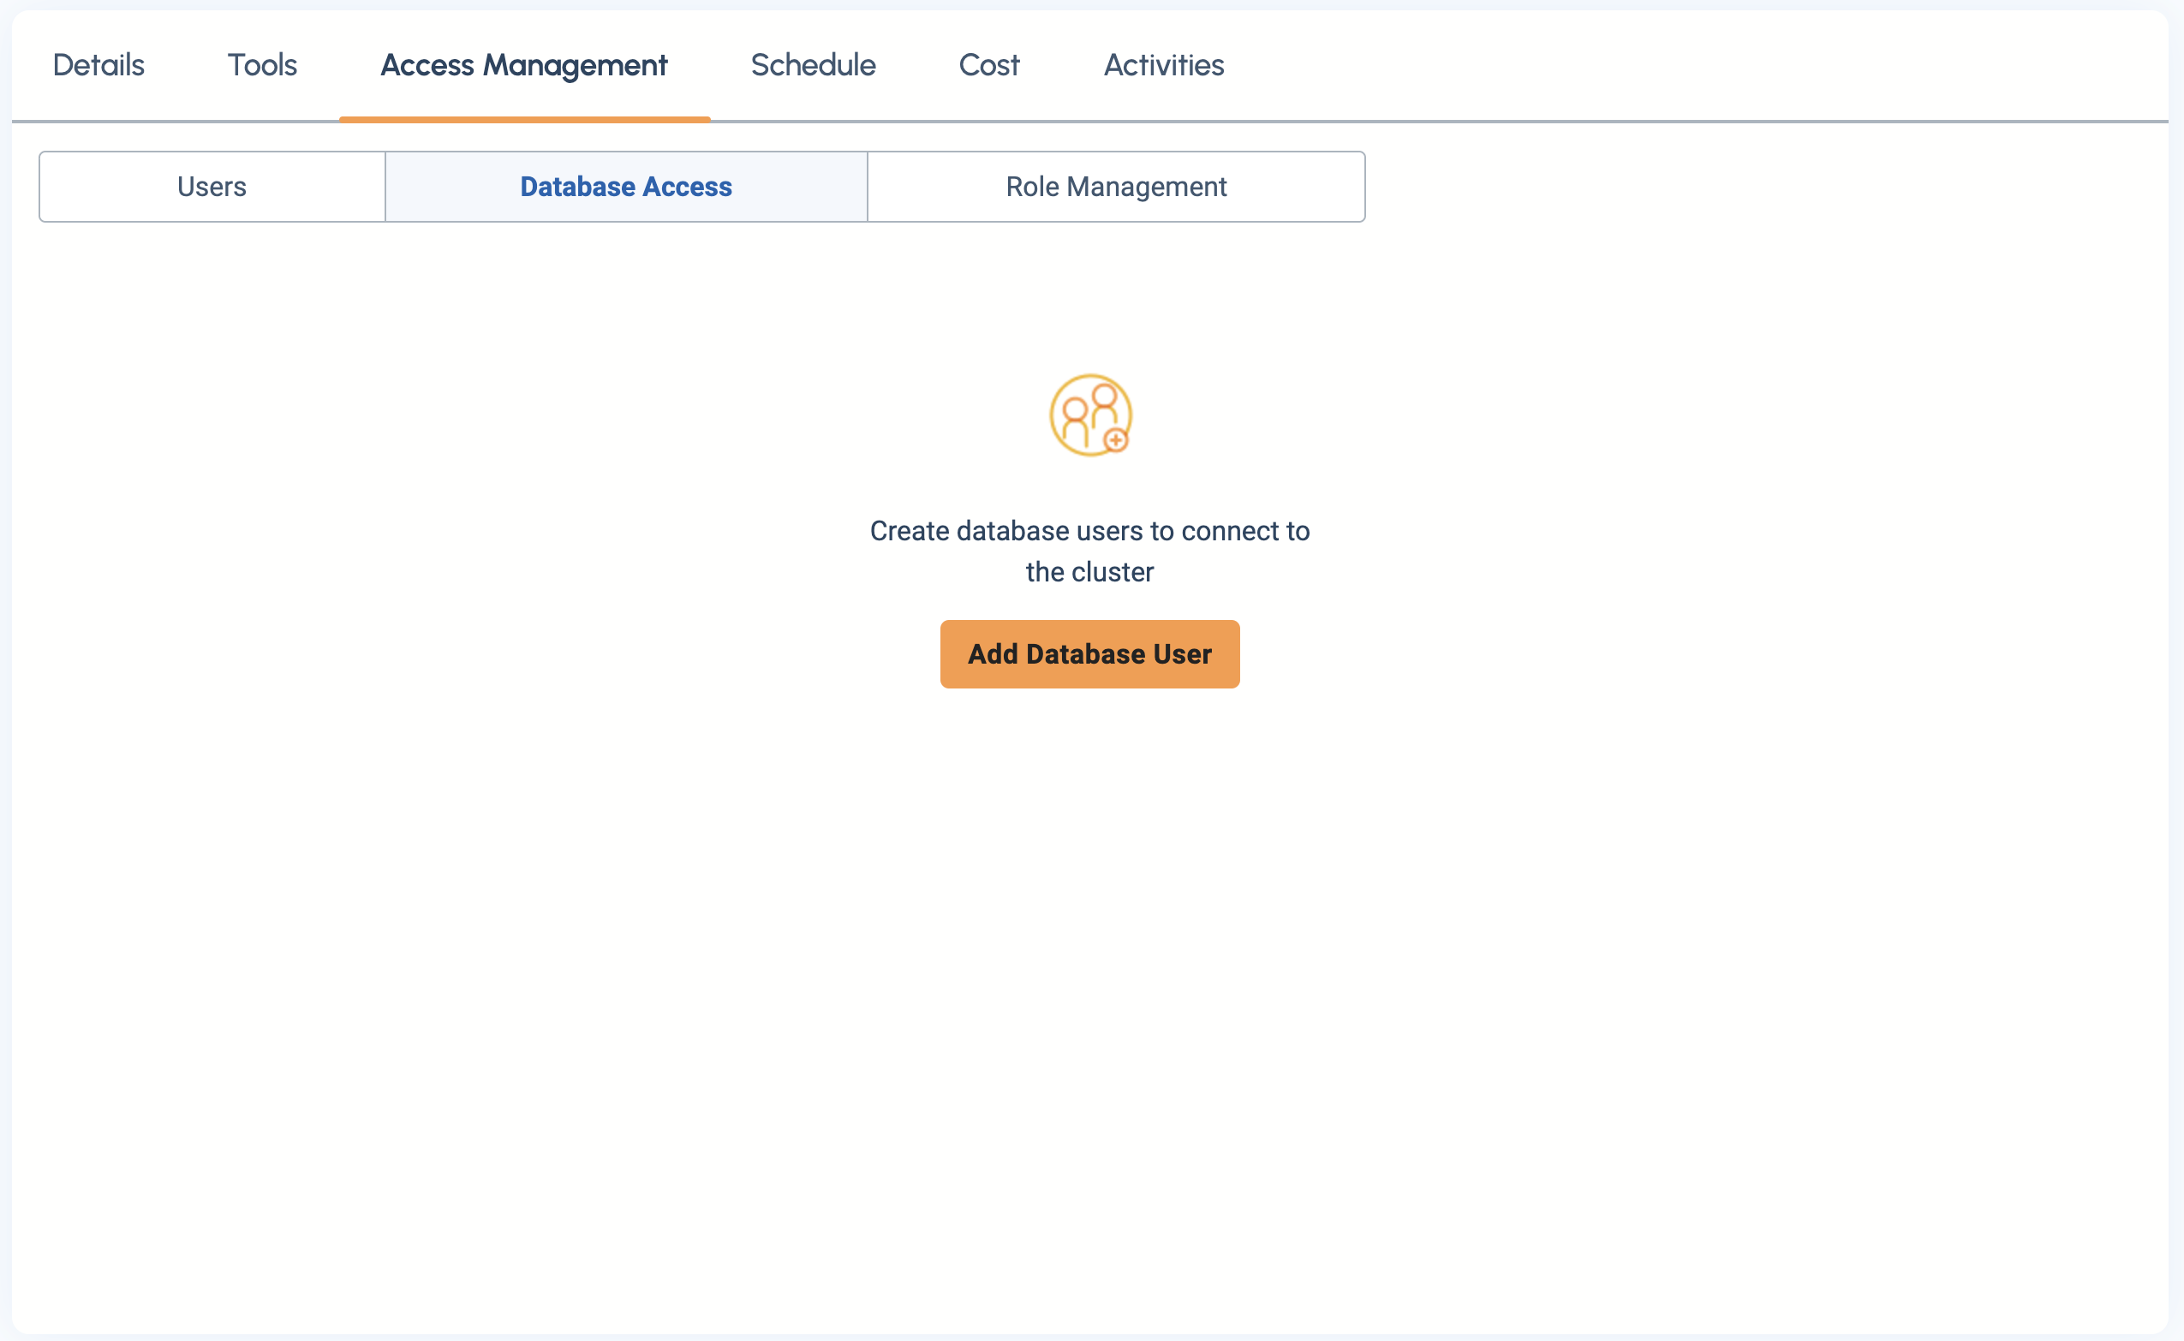
Database Access
Click Here

Slide 18
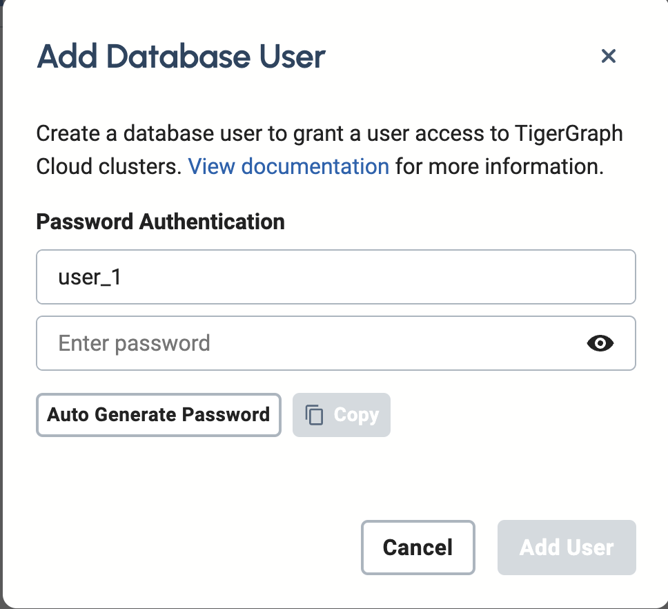
Adding Database User
Set username
Set password
Or auto generate password

Slide 19
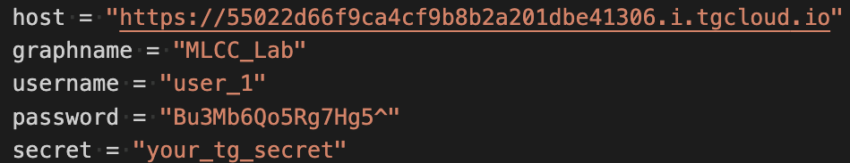
Copy and paste username and password into python code

Slide 20
Where to find your Graph Name
Click Here

Slide 21
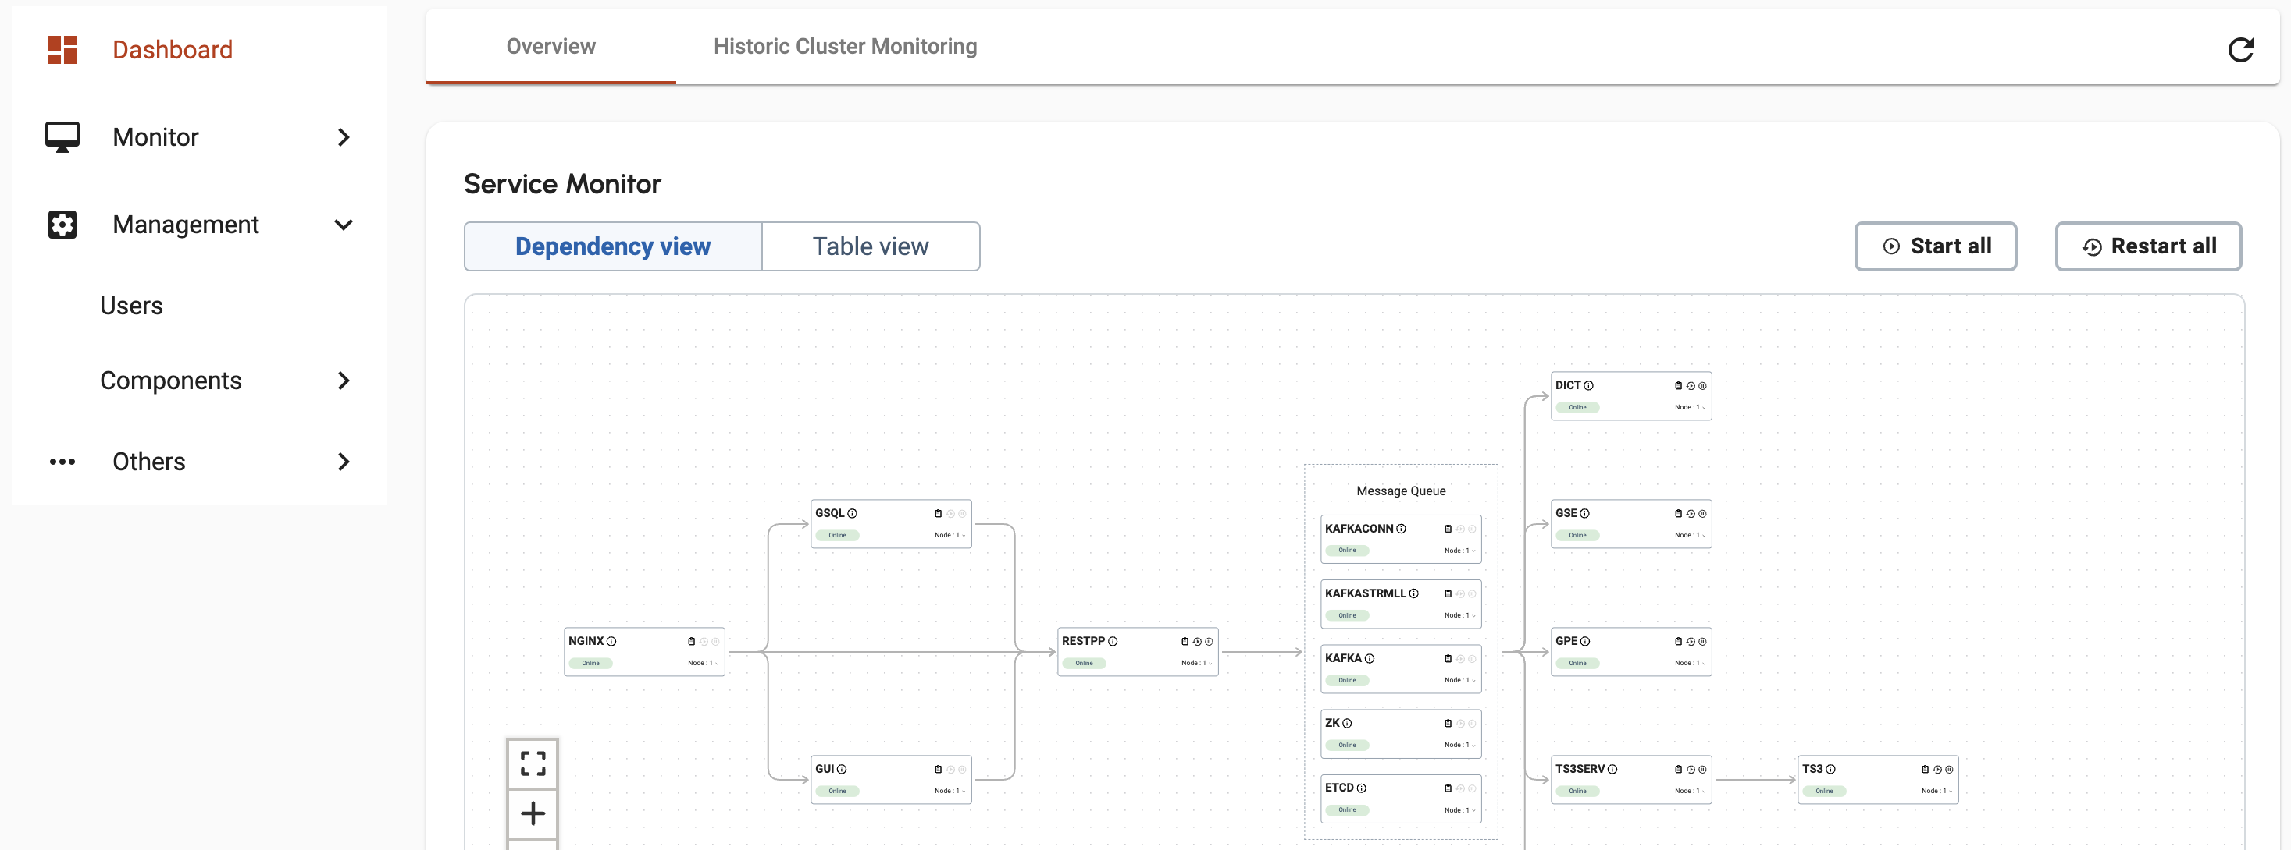
Admin Portal
Click Here

Slide 22
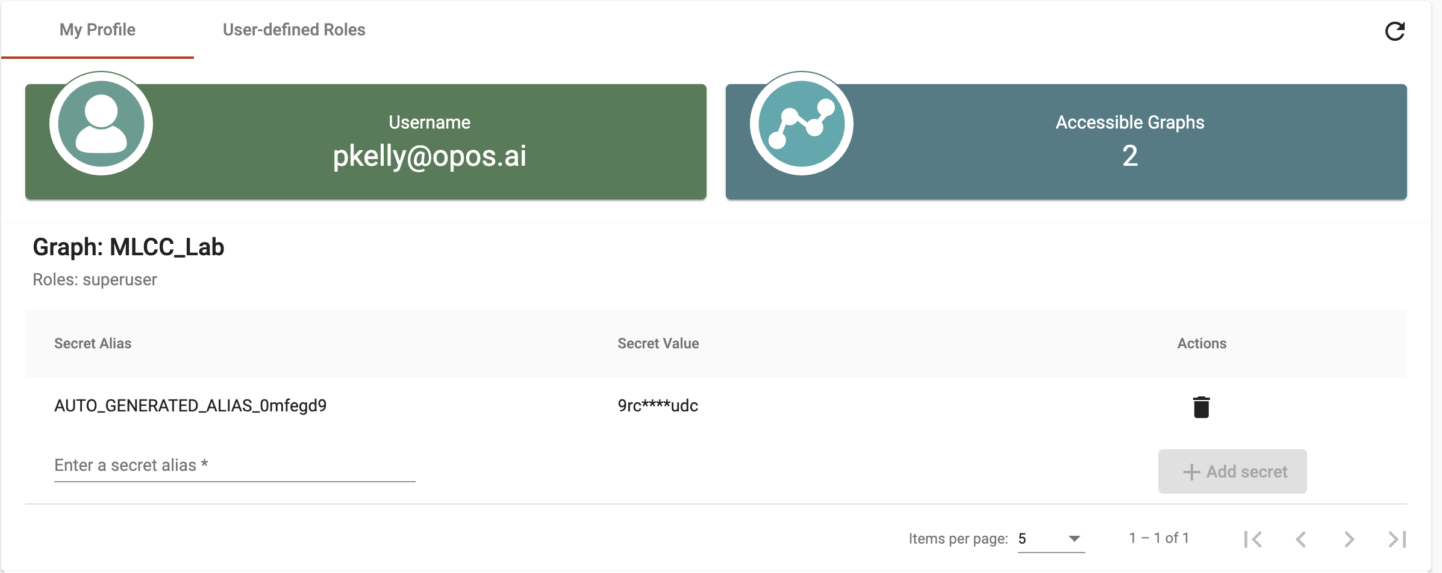
Adding an alias
Create Alias

Slide 23
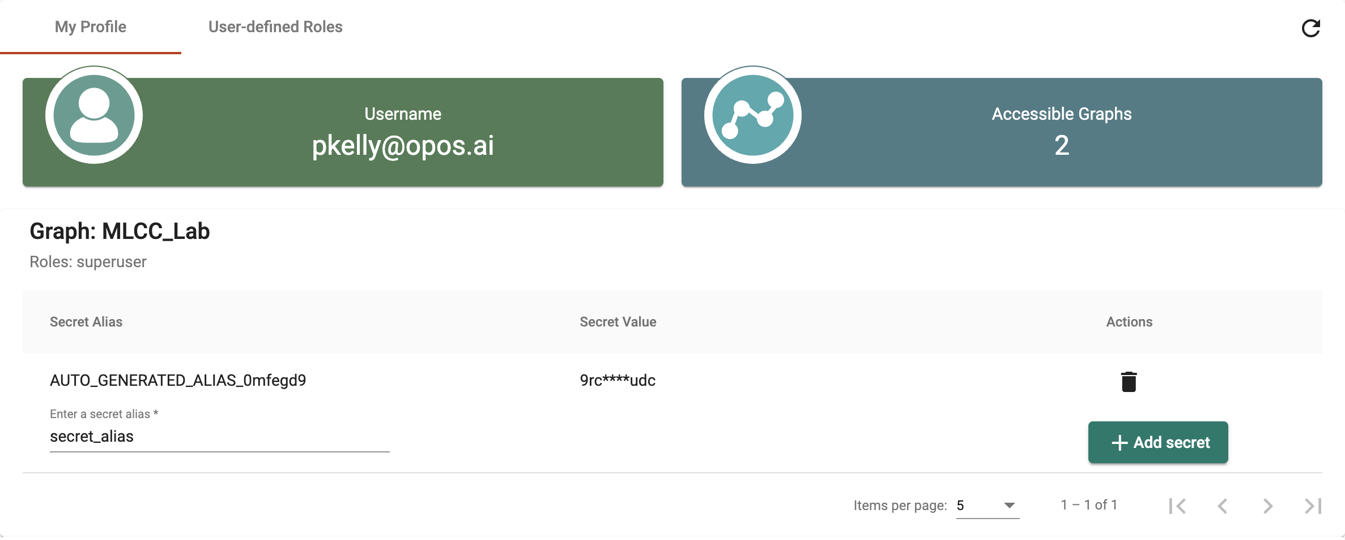
Generating a secret
Add secret

Slide 24
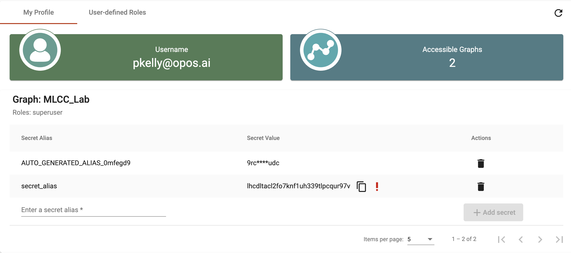
Copy secret
Click here to copy

Slide 25
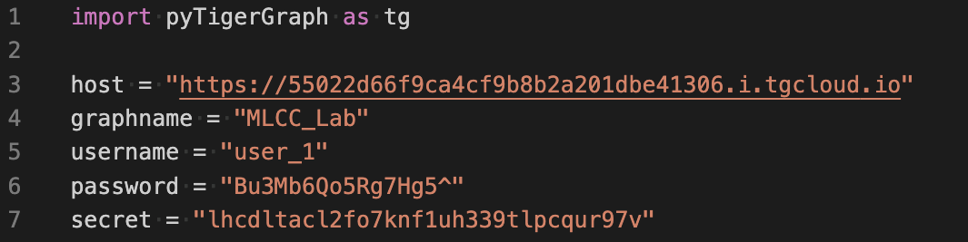
Paste into code

Slide 26
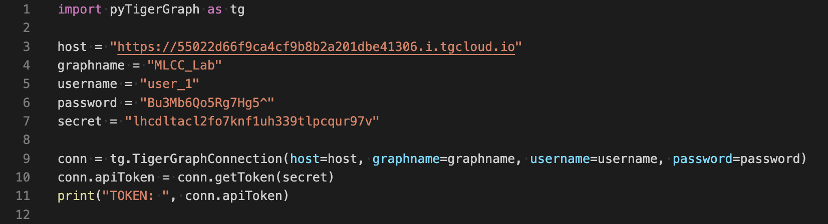
Test Connection
Your code should look like this so far, but with your unique host, graphname, username, password, and secret.
You should get something like this printed out in the terminal

Slide 27
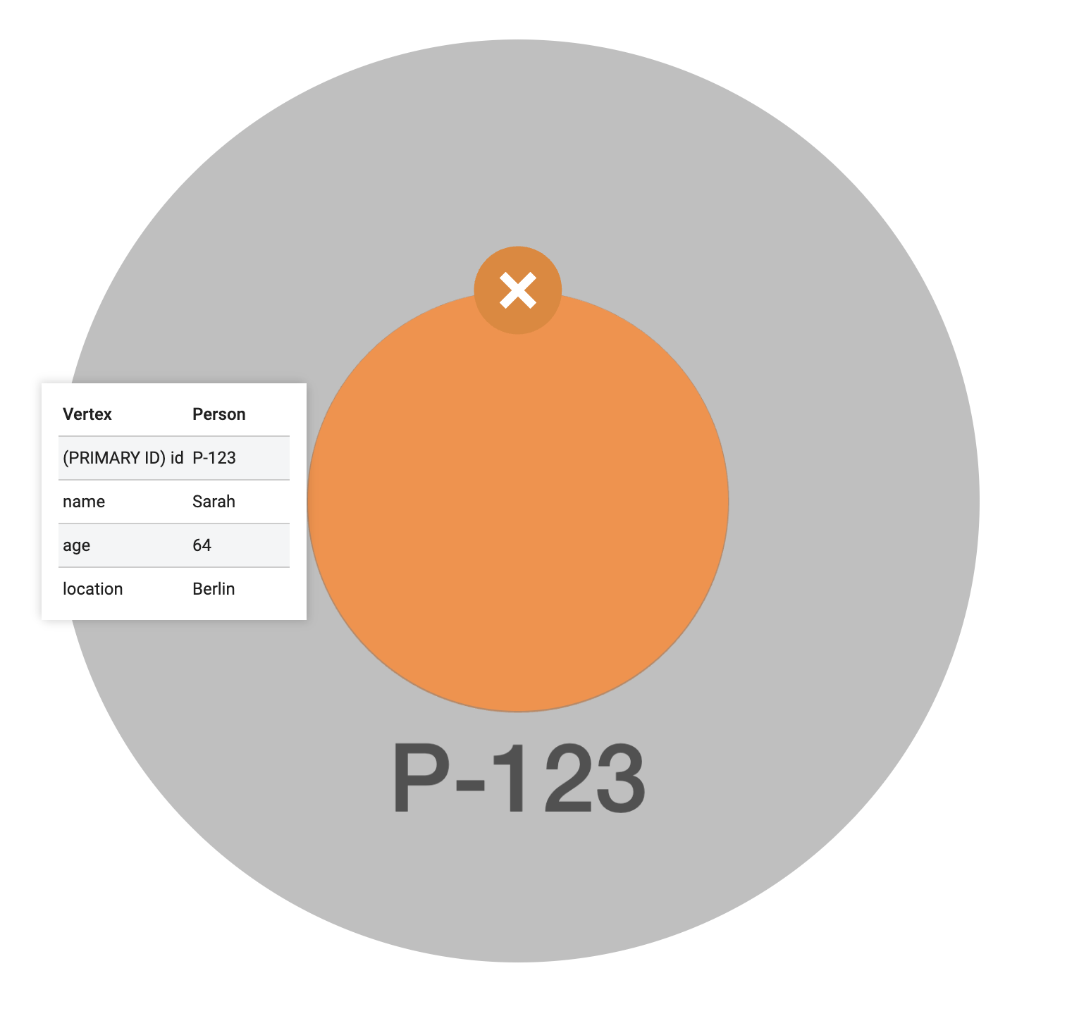
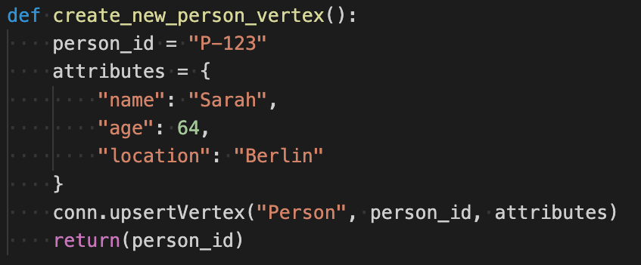
Creating a new Vertex Instance with python

Slide 28
upsertVertex?
upsertVertex is a pyTigerGraph function that inserts the data into a new vertex or updates the data if the vertex already exists
Vertex Name
Instance ID
Instance Attributes

Slide 29
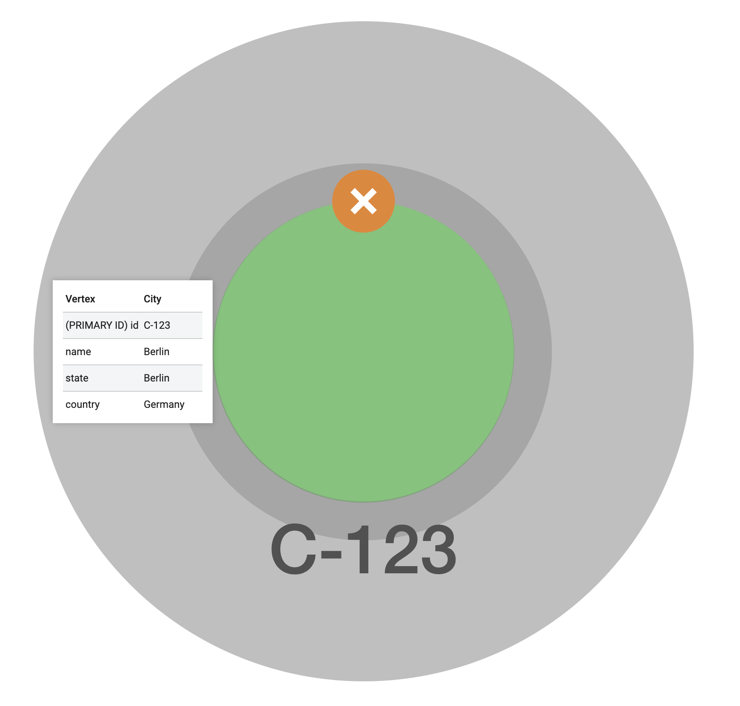
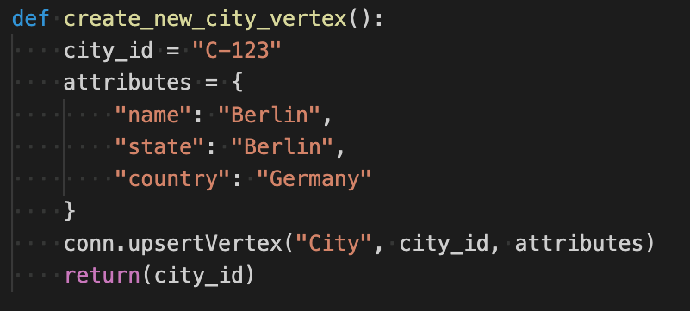
Let’s upsert another Vertex for a city.

Slide 30
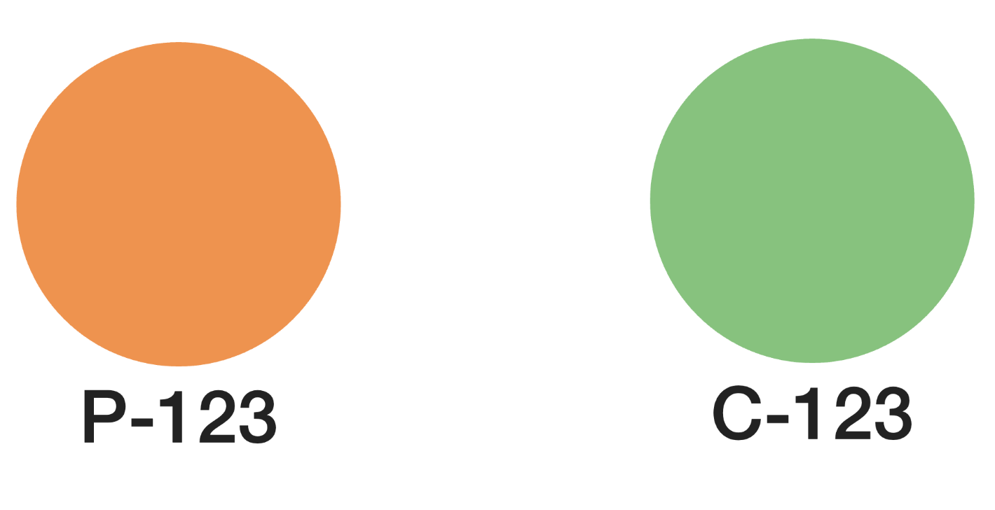
Now we have an instance of a person, and a city.

Slide 31
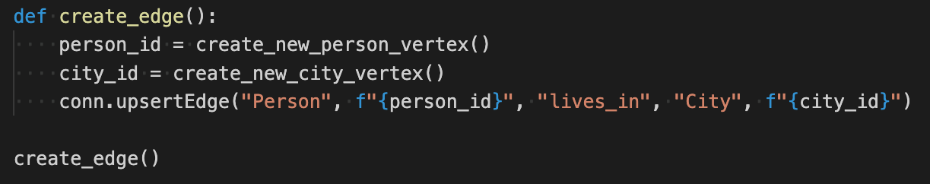
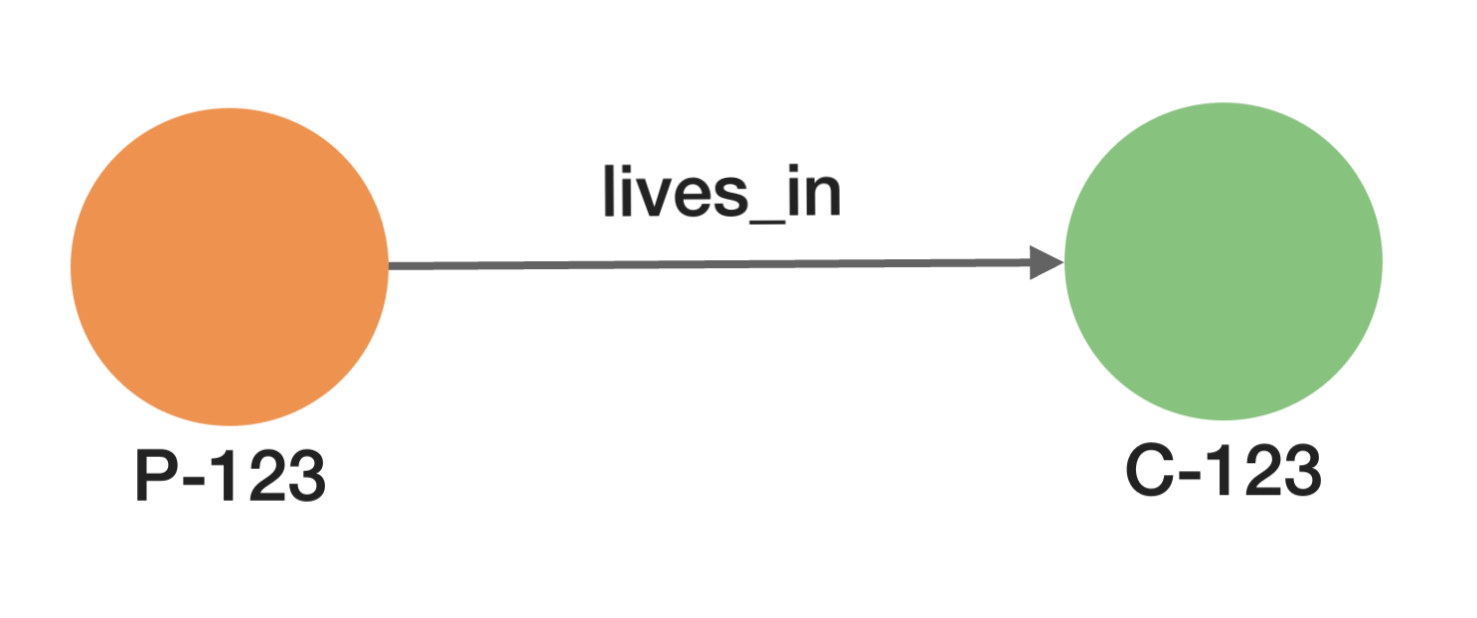
Let’s connect them with an edge

Slide 32
Understanding the code
Runs the function create_new_person_vertex to create a person instance
Runs the function create_new_city_vertex to create a city instance

Slide 33
Upsert Edge
Sending Vertex Name
Instance ID
Edge Name
Receiving
Vertex Name
Instance ID

Slide 34
What to do next?
Write your own python functions to upload data into TigerGraph
Write a function that uploads a single Billing instance with the Billing attributes. (Bill_Amt)
Write a function that uploads a single Month instance.
Connect the Month instance to the bill instance with an edge.
Turn in python code and in image of the two connected instances.

